Slide 1



Welcome to
Middle School
Admissions!
Office of Student Enrollment
schools.nyc.gov/MS
1

Slide 2



Middle School Admissions Timeline
Key Dates
2021-2022 MS Admissions Timeline
Account Creation Letters
Application Period
Application Offers
Waitlists
October 2025
October 15 - December 12
April 15, 2026
September 2026
2
Notes:
Let’s start by taking a look at this year’s updated admissions timeline.
In early October, Welcome Letters were made available in MySchools.
On October 15, the middle school application opened and the deadline to apply is 12/12
April 15 offers will be available and Waitlists will be made available.

Slide 3
How do we apply to
NYC public middle schools?
3

Slide 4
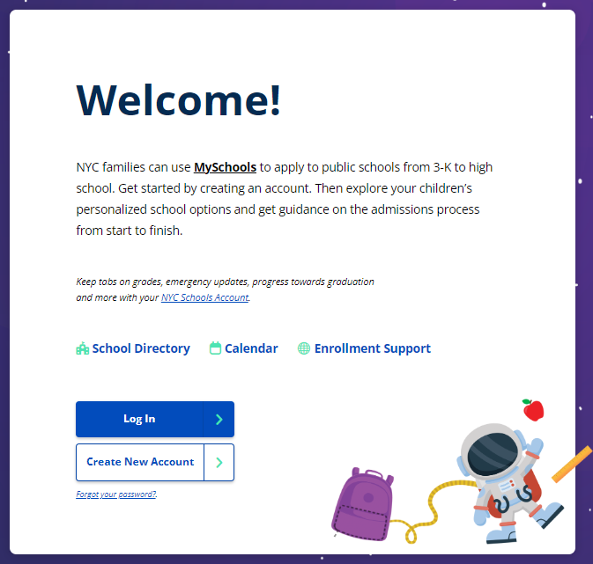
The best way to apply is online at MySchools.nyc
Already have an account?
Just log in! Reset your password if needed.
Don’t have an account yet?
To add your child to your MySchools account, you will need:
  Your child’s unique account creation code (in their account creation letter).
  Your child’s student ID (OSIS #).
Need a copy of your account creation letter?
Public school families: Reach out to your child’s current school.
Private school families: Contact a Family Welcome Center at schools.nyc/fwc.
Notes:
The best way to apply is online at MySchools.nyc.
If you already have a MySchools account, simply log in. If you've forgotten your password, there's an option to reset it.
For those who are new to MySchools, you'll need to create an account.
To do so, you'll require two pieces of information: your child's unique account creation code and their student ID, also known as the OSIS number.
If you haven't received your child's welcome letter, which contains the account creation code, please contact your child's school.
For families from public schools, reach out directly to the school office.
For families from private or parochial schools, please contact a Family Welcome Center.

Slide 5

Seat Groups
Each middle school program has a set number of seats for incoming students.
There are specific seats for general education students (GE), and students with disabilities (SWD).
Applicants are automatically assigned to one group of seats based on the student's instructional program.
Students with Disabilities (SWD)
Receive special education instructional programming for more than 20% of their academic program.
General Education Students (GE)
Receive special education instructional programming for 20% or less of their academic program.
5
Notes:
Let’s talk about seat groups. In middle school admissions, there are two main groups: SWD, which stands for Students with Disabilities, and GE, or General Education.
Families can’t choose which group their child is in. It's determined by their Individualized Education Program, or IEP. To be considered for the SWD group, a student must receive more than 20% of their instruction in special education. Services like counseling or therapy don't count towards that 20%.
So, SWD students will be considered alongside other SWD students, and GE students will be considered with other GE students.

Slide 6

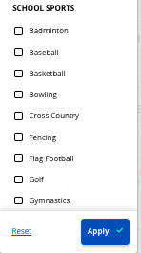
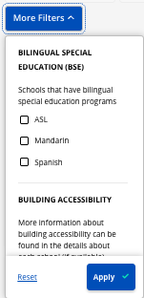
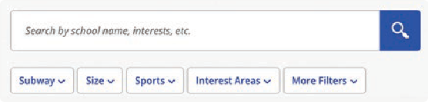
Learn About Middle Schools
Explore your options at MySchools.nyc!
Use the search and filter options to find schools based on what matters most to you, from location to offerings, such as language courses and sports.
Use search terms
Means that
Look up information about specific schools or programs by typing their names into the search bar.
You may also type other key words to find programs that meet your child’s needs and interests. You can search by activities, such as “dance” or courses, such as computer science.
6
Notes:
There are a significant number of middle schools to apply to and we know that some families look for specific types of schools.
Explore your options at MySchools.nyc! Use the search and filter options to find schools based on what matters most to you, from location to offerings, such as language courses or a focus on athletics.

Slide 7
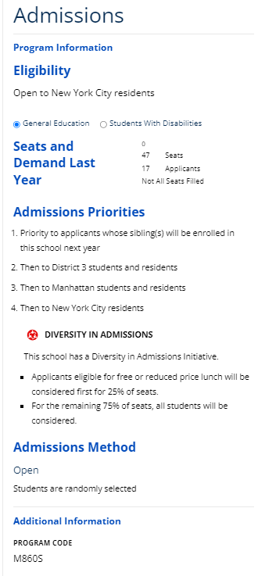
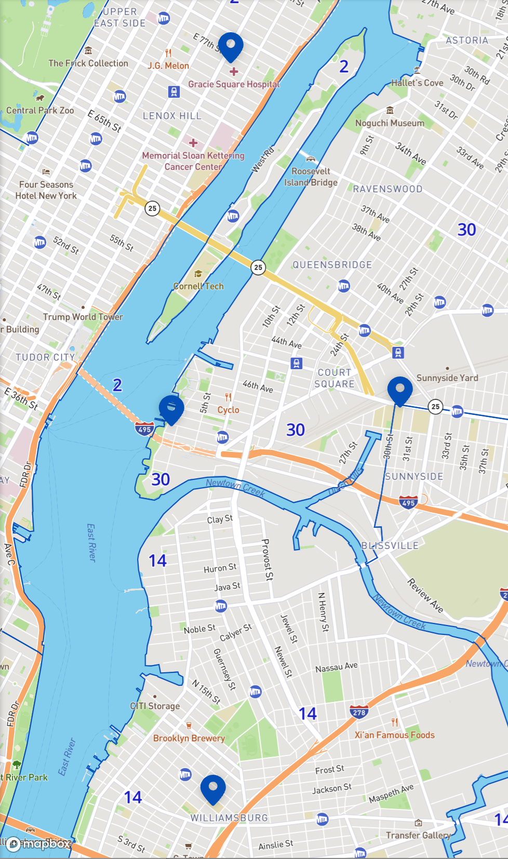

How students get middle school offers | Four factors
1. Choices on the application
The programs you include in your child’s application AND the order in which they are placed.
2. Seat availability and Demand
The number of seats available for applicants.
3. Admissions Priorities
The order in which groups of applicants are considered.
4. Admissions Methods
How students are matched with individual seats.
#
7
Notes:
How do students get offers? There are a few factors that determine your child’s middle school offer.
The most important factor in where your child gets an offer are the choices on your application AND the order in which they are placed.
There are also a few other factors;
Seat availability. All middle schools have a set number of available seats for incoming students.
Another is admissions priorities, which are the order in which groups of applicants are considered for placement.
The last are admissions methods, which is how students are matched with individual seats. Most programs will use the random selection process which assigns random numbers to individual students . But There are also programs that rank students based on a rubric.
Let’s talk more about all of these.

Slide 8

Admissions Priorities
If there are more applicants to a program than seats available, students will be considered for offers in groups based on that program’s admissions priorities.
  All applicants in priority group 1 will be considered first.
  Then, if seats are still available, applicants in priority group 2 will be considered next, and so on.
Example
A zoned program may have a priority for zoned students. This means that all zoned applicants get offers before any non-zoned applicants.
Means that
To keep your admissions priority to a school, include it on your application. You do not need to list it first: you will keep the same priority to attend this school whether you rank it first, third, or last. This means that if you prefer any programs to your zoned or continuing K-8 school, place your preferred programs higher on your application.
8
Notes:
Another key admissions factor is the program’s Priority Groups which shows what order students are considered for offers to that program. Different programs have different priority groups, and some programs don’t use admissions priority groups to make offers.
If there are more applicants to a program than seats available, students will be considered for offers in groups based on that program’s admissions priorities.
All applicants in priority group 1 will be considered first.
Then, if seats are still available, applicants in priority group 2 will be considered next, and so on.
Students do not need to list a program first to keep the same priority to attend a middle school whether a family ranks it first, third, or last. This means that if families prefer any programs to their zoned or continuing K-8 school, they should place their preferred programs higher on their application.

Slide 9
Common Admissions Priorities
Sibling Priority
Priority to residents of the zone
Priority to continuing fifth graders
Priority to students and residents of the district (or borough)
Priority to applicants eligible for free and reduced lunch (FRL) for up to 50% of seats
9
Notes:
Here are the most common admissions priorities:
Sibling Priority
Priority to residents of the zone
Priority to continuing fifth graders
Priority to students and residents of the district (or borough)
Priority to applicants eligible for free and reduced lunch (FRL) for up to 50% of seats
Sibling-
At schools where the final year is eighth grade, middle school applicants with siblings currently in sixth or seventh grade have priority to attend their sibling’s school. If the school has younger grades (for example, grades K–8), middle school applicants with siblings currently in grades kindergarten - seventh grade have priority to attend their sibling’s school.
At schools that continue through twelfth grade, middle school applicants with siblings currently in grades 6 – 11 have priority to attend their sibling’s school.
Continuing
Students who currently attend a school that continues to grade 8 or 12 are guaranteed an offer to their school’s middle school program if they include it on their application. You do NOT need to place your child’s continuing school as your first choice to keep your guarantee, but you do need to include it on your application.
Zone
Priority to residents of the zone
Students who are zoned to a middle school have priority to attend the zoned program at that school. To get this priority, add your zoned program(s) to your child’s application. You do NOT need to place your zoned program as your first choice to get this priority.
DIA
Priority to applicants eligible for free and reduced lunch (FRL) for up to 50% of seats
This is one example of a Diversity in Admissions (DIA) priority. In this case, applicants whose families meet a specific income requirement have an admissions priority to 50% of seats in this program.

Slide 10
Applying with Multiples (Twins, Triplets, etc.)
What are Multiples?
Multiples refer to two or more siblings (twins, triplets, etc.) applying to the same grade level who share a parent/guardian connected to the same MySchools account.
How to Apply Together
If you want your children to have the highest possible chance of getting the same offer, you should submit identical applications. MySchools makes this process easy:
  You only need to add choices to one child's application.
  Before submitting, MySchools will ask if you want to copy those choices to your other child's (or children's) application.
  By doing this, your students are connected to the strongest random number generated for your group once the application closes.
Important: When Offers Might Differ
Even with identical applications, students may not always receive the same final offer. This happens when certain program characteristics apply, and only one student ranks high enough:
  Screened, Audition, or Language Criteria Programs: Admission is based on individual assessment or criteria.
  Seat Groups: Students are in different seat groups (e.g., GE vs. SWD).
10
Notes:
Multiples Policy (Identical Applications)
Students applying to the same grade level who are connected to the same parent/guardian MySchools account (multiples) may submit identical applications to share the same random number.
Process:
Parents add program choices to one application only.
MySchools prompts the parent to copy those choices to the remaining sibling(s) before final submission.
Students are matched to the stronger random number generated by the system.
Key Exception: Students may not receive the same offer if characteristics affect individual admission, such as being in different seat groups (GE vs. SWD), or applying to screened, audition, or language criteria programs where only one student's individual ranking is high enough.

Slide 11
Admissions Methods
An admissions method is the way a program considers applicants for available seats.
  Zone Priority: students receive a priority to the school if their home address is part of that school’s zone.
  Open: students are randomly selected.
  Screened: students are selected based on their academic record.
  Language Criteria: students are selected based using language data, such as home language and English language learning status.
  Audition: students are considered based on their score from an audition.
Randomly Assigned Numbers
Each applicant is assigned a random number as part of the admissions process. If there are fewer available seats than applicants within a priority group, these randomly assigned numbers determine the order in which students get offers.
Programs that use auditions, talent tests, or academic information, students are admitted in an order determined by the selection criteria.
11
Notes:
The fourth factor is a program’s Admissions Method. An admissions method is the way a program considers applicants for available seats.
There are 5 admissions methods.
Zoned Priority: students receive a priority to the school if their home address is part of that school’s zone.
Open: students are randomly selected.
Screened: students are selected based on their academic record.
Language Criteria: students are selected based using language data, such as home language and English language learning status.
Audition: students are considered based on their score from an audition.
As you get ready to submit your child’s middle school application, make sure that you understand the programs' admissions methods for which you are applying to.

Slide 12
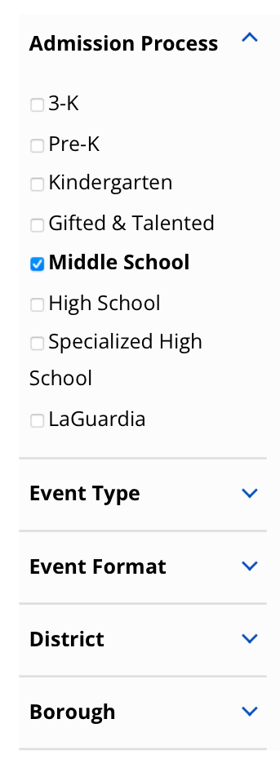
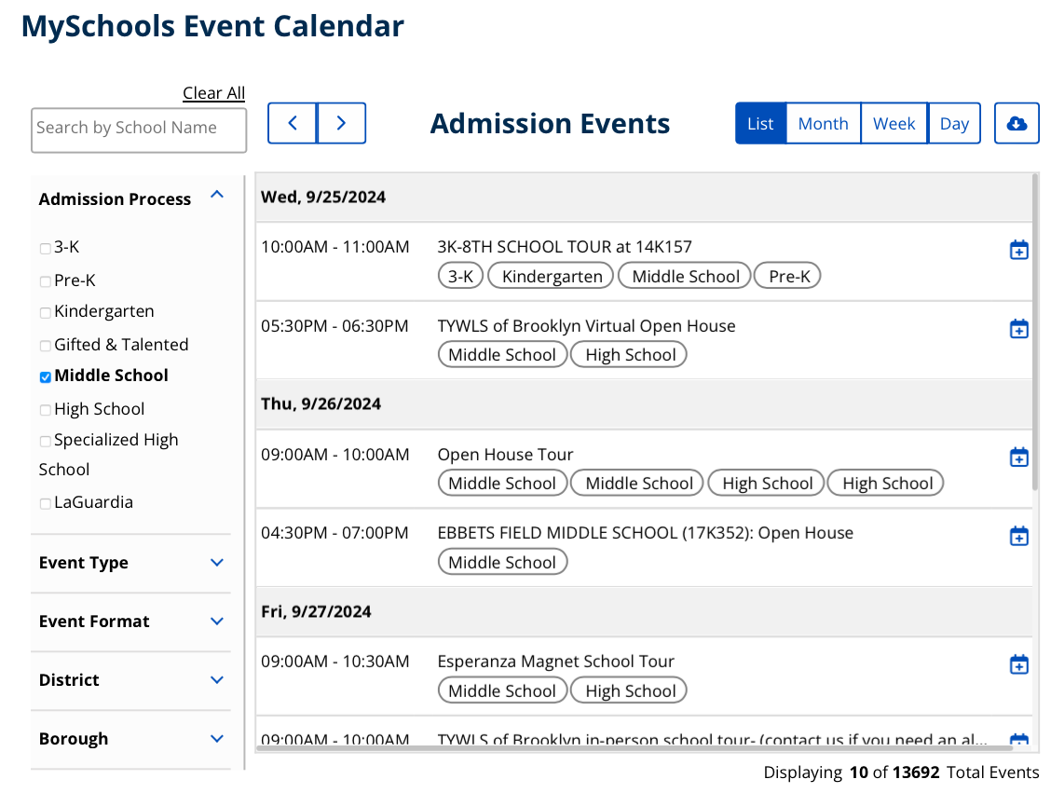
Learn about Middle Schools | MySchools Events Calendar
You can filter for event format: virtual or in person, admissions process, district, or borough.
12
Notes:
Now let's talk about the MySchools Events Calendar.
Find out if middle schools of interest are hosting any in-person or virtual events.
This valuable tool can help you stay informed about upcoming events related to middle school admissions.
The MySchools Events Calendar allows you to filter for specific events based on various criteria.
You can filter by event format, whether it's virtual or in person.
Additionally, you can filter by event type, such as admissions processes, school tours, or open houses.
You can also narrow down your search by district or borough.
By using these filters, you can easily find events that are relevant to your needs and interests.
The calendar provides detailed information about each event, including the date, time, location, and a brief description.
The MySchools Events Calendar is a great resource for staying up-to-date on middle school admissions events.

Slide 13
Offer Release and Waitlists
Offers will be available April 15
We’ll notify families and schools when offers are available.
Every student receives one middle school offer, and it's automatically accepted.
After offers are released, the waitlist process will begin.
Your child will be automatically waitlisted at any programs ranked higher than the program to which they got an offer.
  For example, if they get an offer to their second choice program, they will be automatically waitlisted at their first choice program.
More information about waitlists, including adding and removing your child from waitlists, will be shared at that time.
Means that
13
Notes:
Offers will be available April 15.
We’ll notify families and schools when offers are available.
After offers are released, the waitlist process will begin.
You will be automatically waitlisted at any programs ranked higher than the program to which you got an offer.
For example, if you get an offer to your second choice program, you will be automatically waitlisted at your first choice program.
More information about waitlists, including adding and removing yourself from waitlists, will be shared at that time.

Slide 14
Resources
Learn more
Middle school admissions | schools.nyc.gov/Middle
Your middle school options | Log in at MySchools.nyc
Middle school admissions email list | schools.nyc.gov/SignUp
Your zoned school(s) | schoolsearch.schools.nyc
Get support with your child’s application
Your school counselor
A Family Welcome Center | schools.nyc.gov/WelcomeCenters
Office of Student Enrollment | 718-935-2009| MSenrollment@schools.nyc.gov
14

Slide 15
Thank you for joining us today!
Questions?
15
Notes:
We appreciate you for joining us today! Now we are going to answer some of your questions.

